Slide 1
YOUR RUBBER TO METAL PARTS SOLUTIONS PARTNER
www.ucelrubber.com

Slide 2
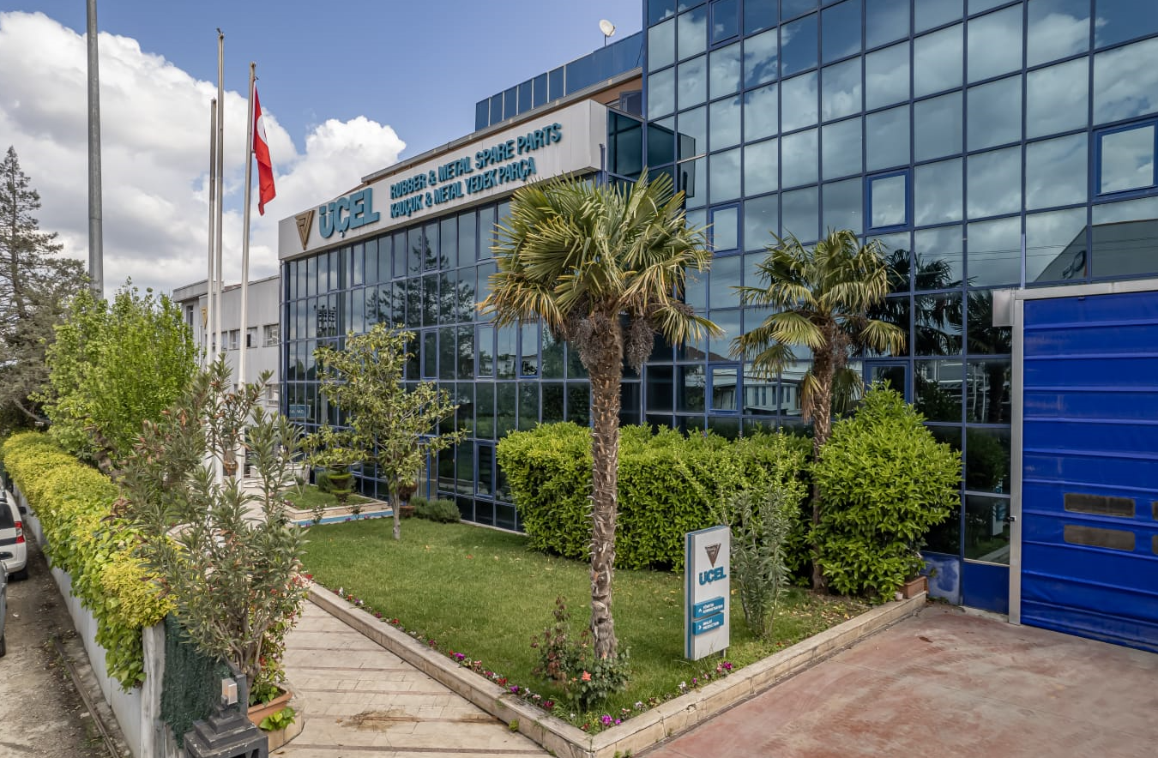
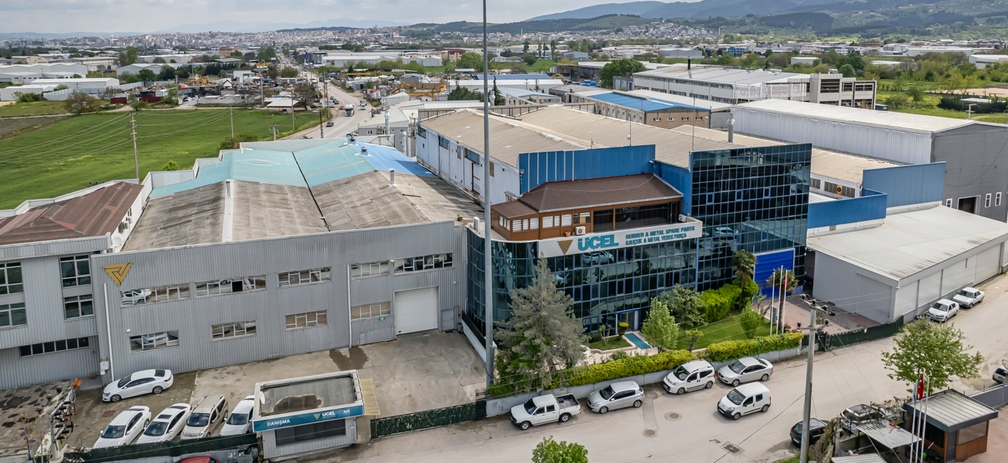
OUR STORY
Established in 1980 in the heart of Turkish automotive sector, Bursa. Managed to be known as equivalent
to OE parts in the domestic market for years with its quality orientated philosophy and dedicated staff,
Following closely OEM activities with
inhouse R&D department and developing testing facilities.
ÜCEL 2023

Slide 3
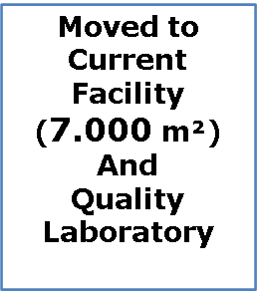
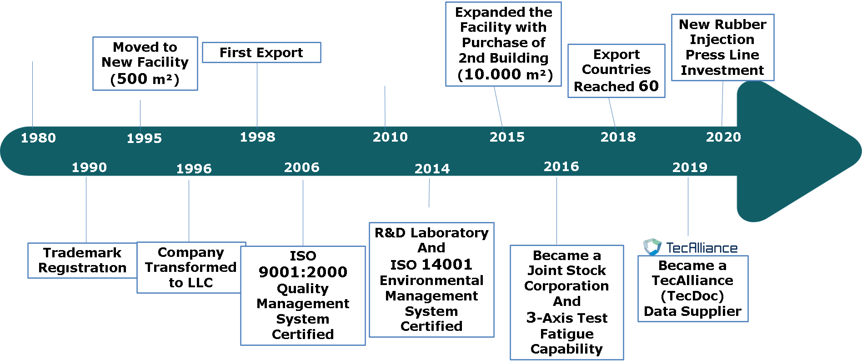
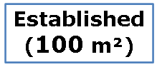
ÜCEL HISTORY
Full automated welding robot
ÜCEL 2023

Slide 4
Mastering manufacturing
Outstanding business support
Unrivalled product offer
we offer a complete and robust program based on these
three pillars.
ÜCEL 2023

Slide 5
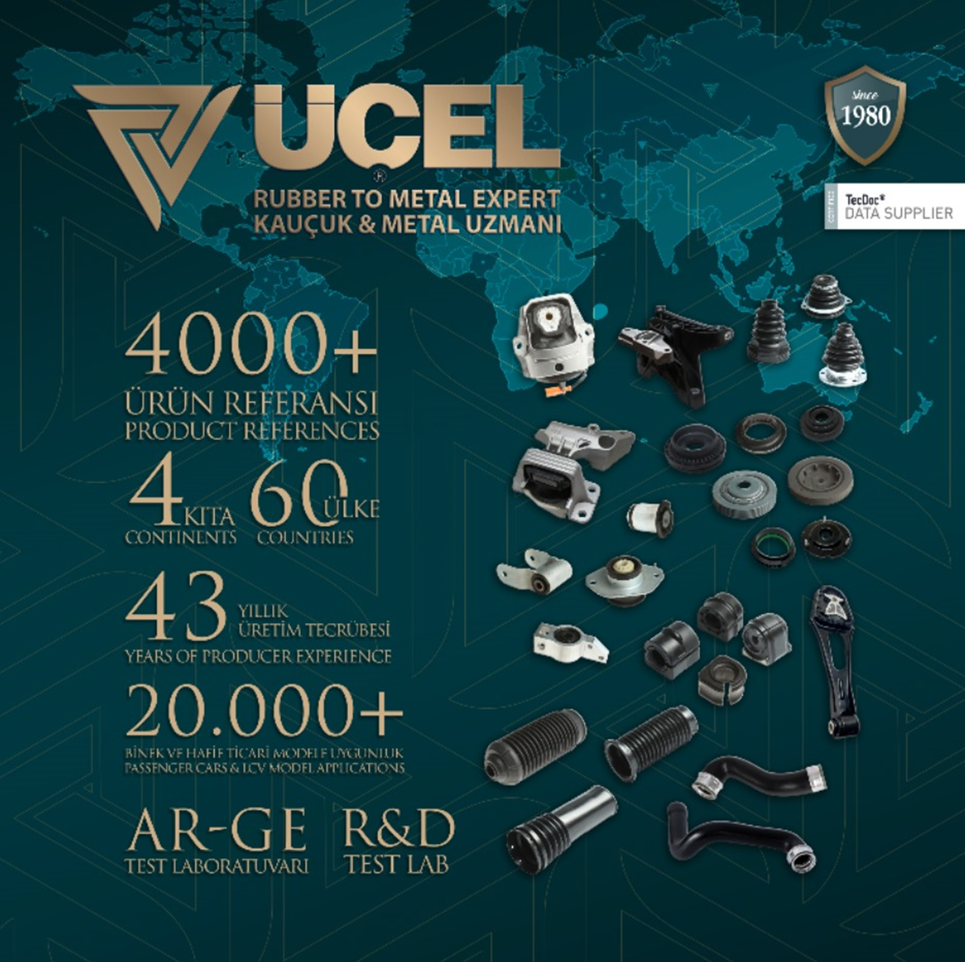
Mastering manufacturing
Outstanding business support
ÜCEL 2023

Slide 6
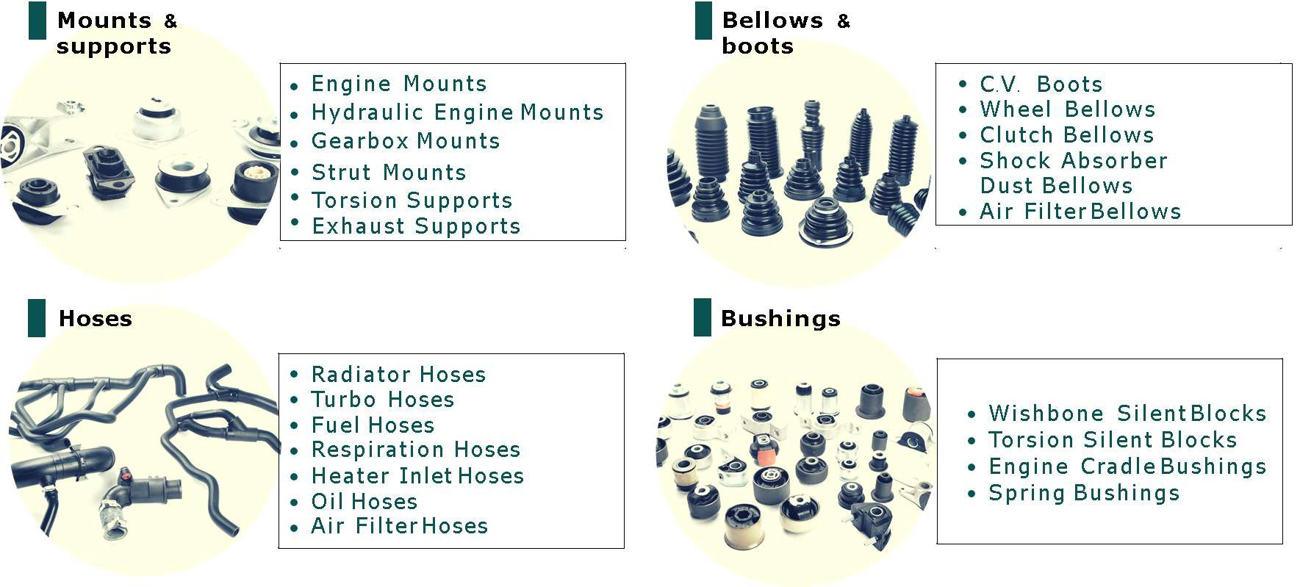
4.000+ product references
2 0.000+ passenger cars & LCV model applications 250 new references every year
ÜCEL 2023

Slide 7
4.000+ product references
2 0.000+ passenger cars & LCV model applications 250 new references every year
ÜCEL 2023

Slide 8
PRODUCTION CAPACITY
Current investments :
28 Pcs Vulcanization Presses
3 Pcs Aluminum Injection Presses 3 Pcs Plastic Injection Presses
7 Pcs Eccentric Presses 3 Pcs Hydraulic Presses
Compound Finalizing Line Surface preparation Line
CNC Profile Length Cutting Line
Parts assembly Line (10 Pcs hydraulic presses)
Pulley (Pully) Production Line (4 CNC Lathes) Tooling Workshop
Fully Automated Welding Robot
Planned investments :
Spectrometer
Automated Parts Assembly Line 3D Printer
ÜCEL 2023

Slide 9
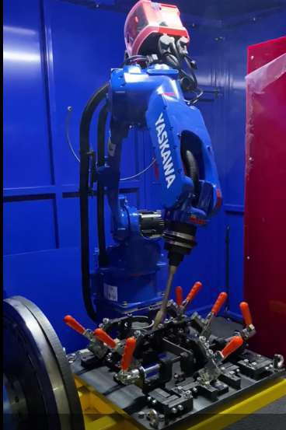
PRODUCTION CAPACITY
TOTAL AREA : 10.000 M2 CLOSE AREA : 8.355 M2
Fully automated welding process
ÜCEL 2023

Slide 10
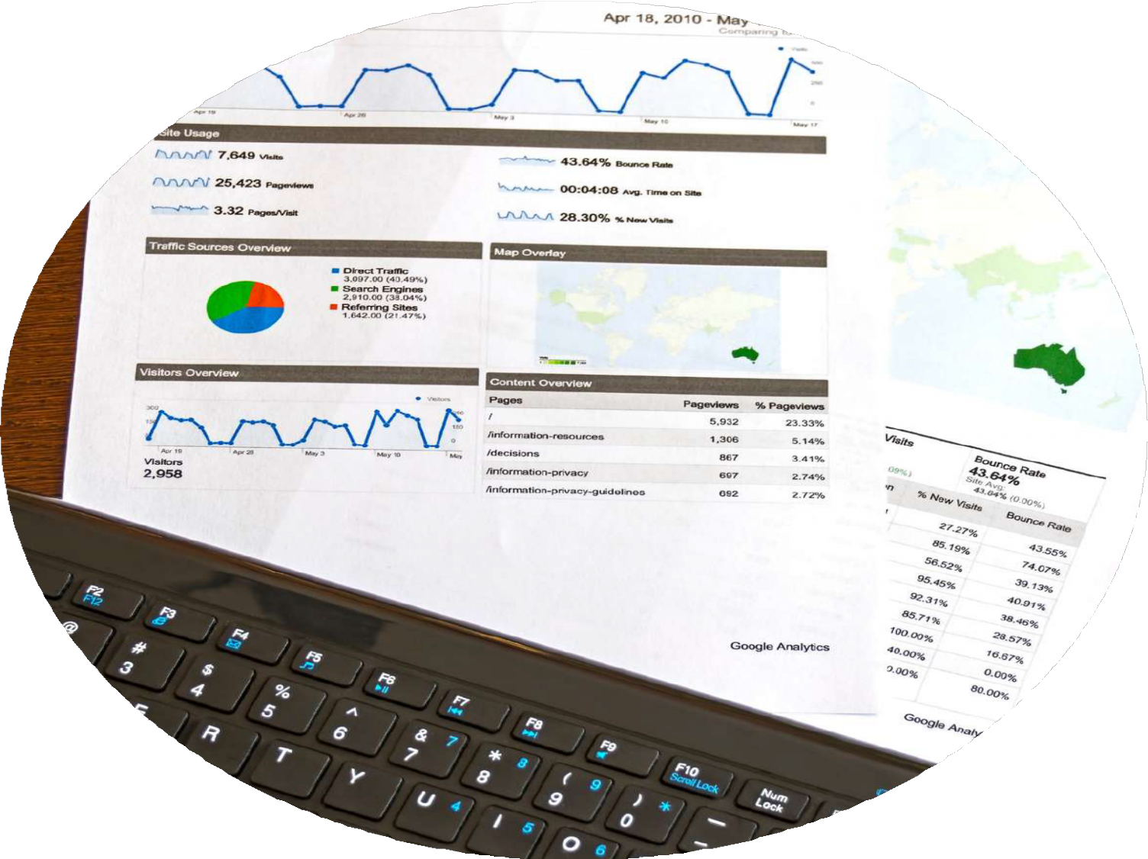
RESEARCH & DEVELOPMENT
Extensive Market Knowledge
Market research and analysis
Deep knowledge and coverage of the local and international car park
ÜCEL 2023

Slide 11
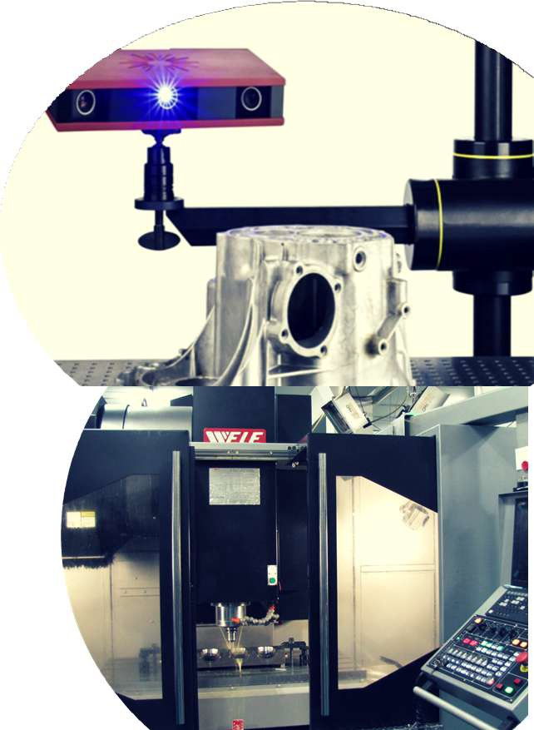
RESEARCH & DEVELOPMENT
High Tech Tools
From Reverse engineering to the CNC
machining and the analysis and simulation,
Software and hardware 3D scanning technology
Automated ATOS 3D metrology. In the standardized measuring machine ATOS
ScanBox, ATOS Triple Scan is used for fully
automated measuring and inspection of parts.
ÜCEL 2023

Slide 12
RESEARCH & DEVELOPMENT
High Tech Tools
Computer aided design (CAD)
Computer aided manufacturing (CAM): Electro discharge machinging (EDM) - CNC machining
CATIA,VISI,MASTERCAM world wide used software for design & modelling
ANSYS, powerful tool for simulation & analysis
ÜCEL 2023

Slide 13
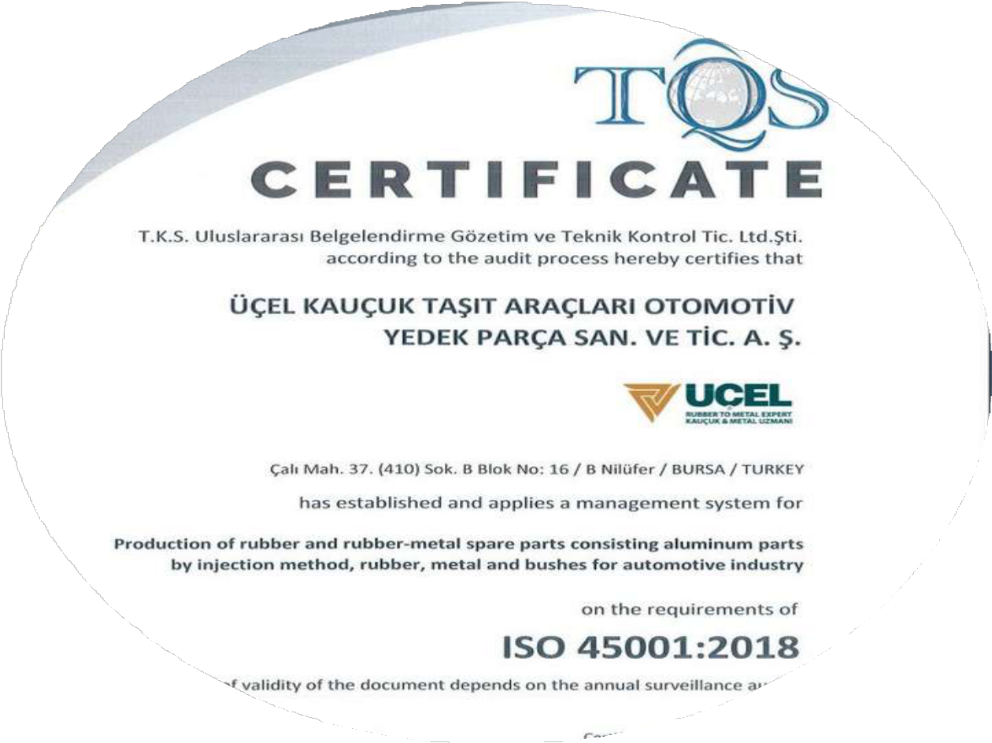
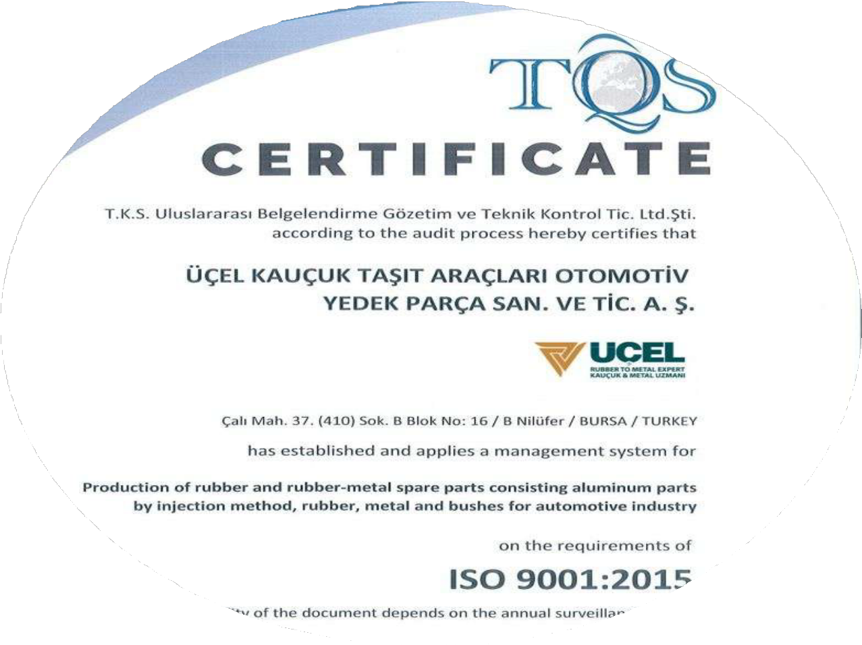
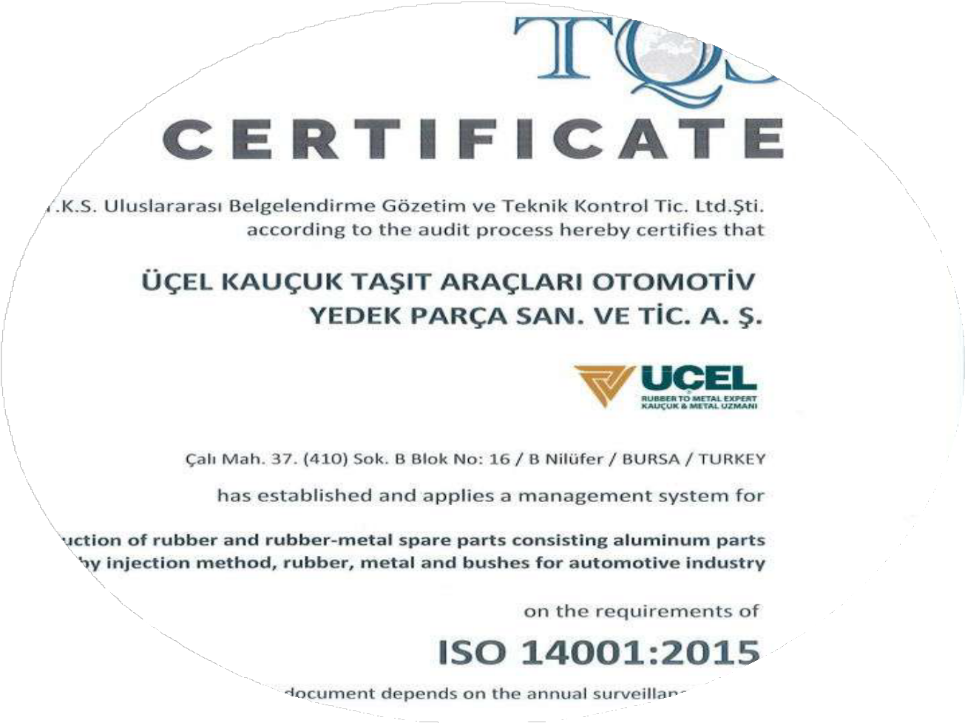
QUALITY MANAGEMENT
ÜCEL 2023

Slide 14
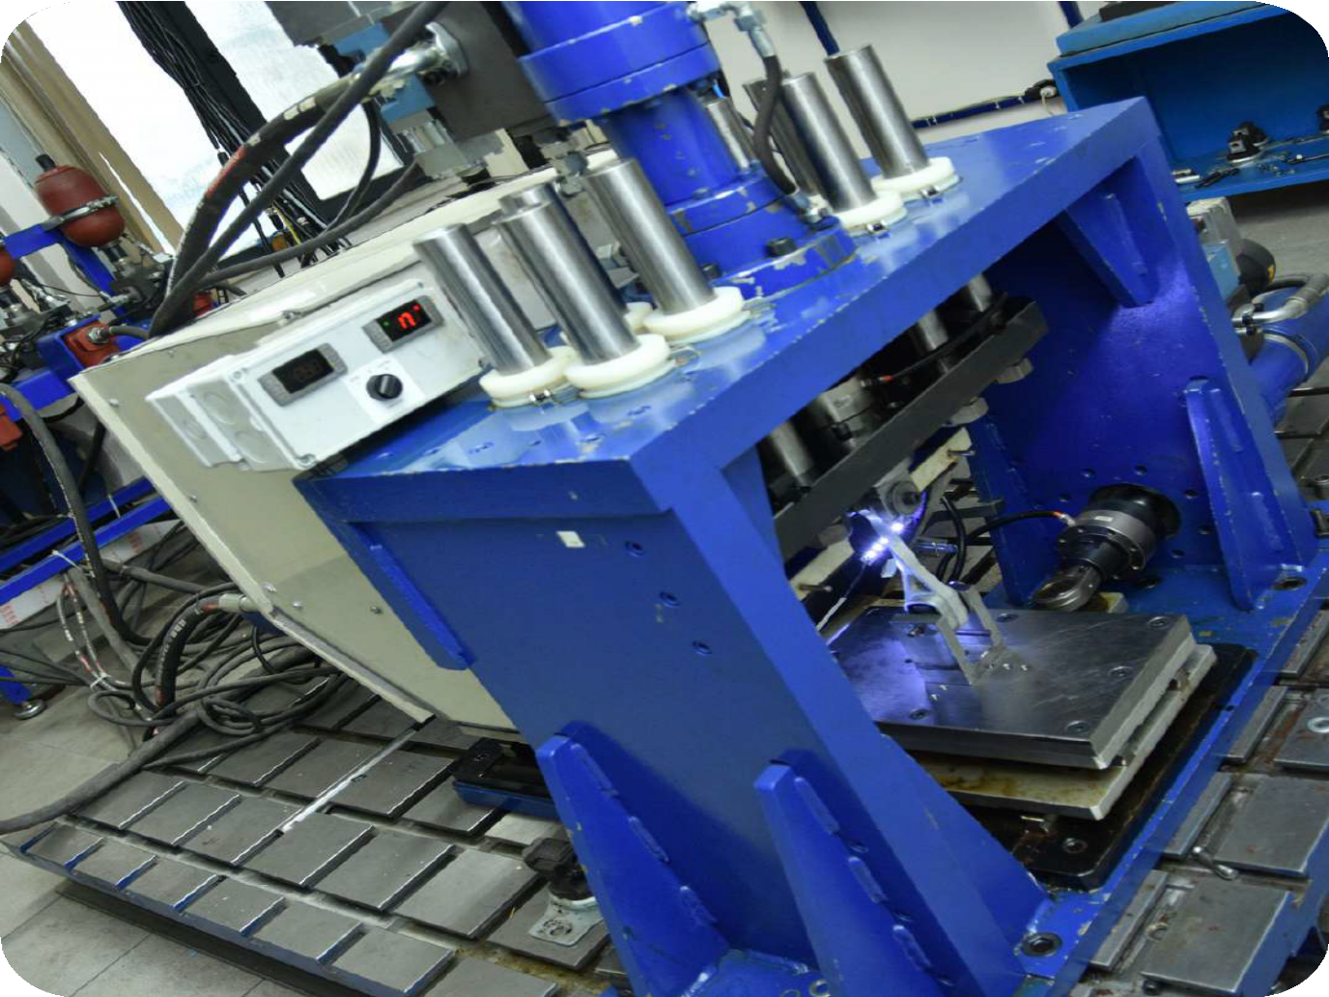
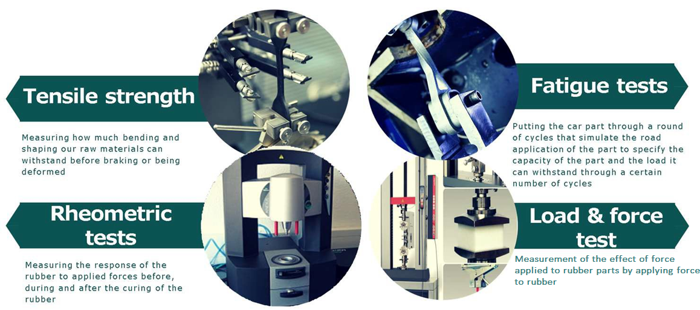
QUALITY CONTROL
ÜCEL 2023

Slide 15
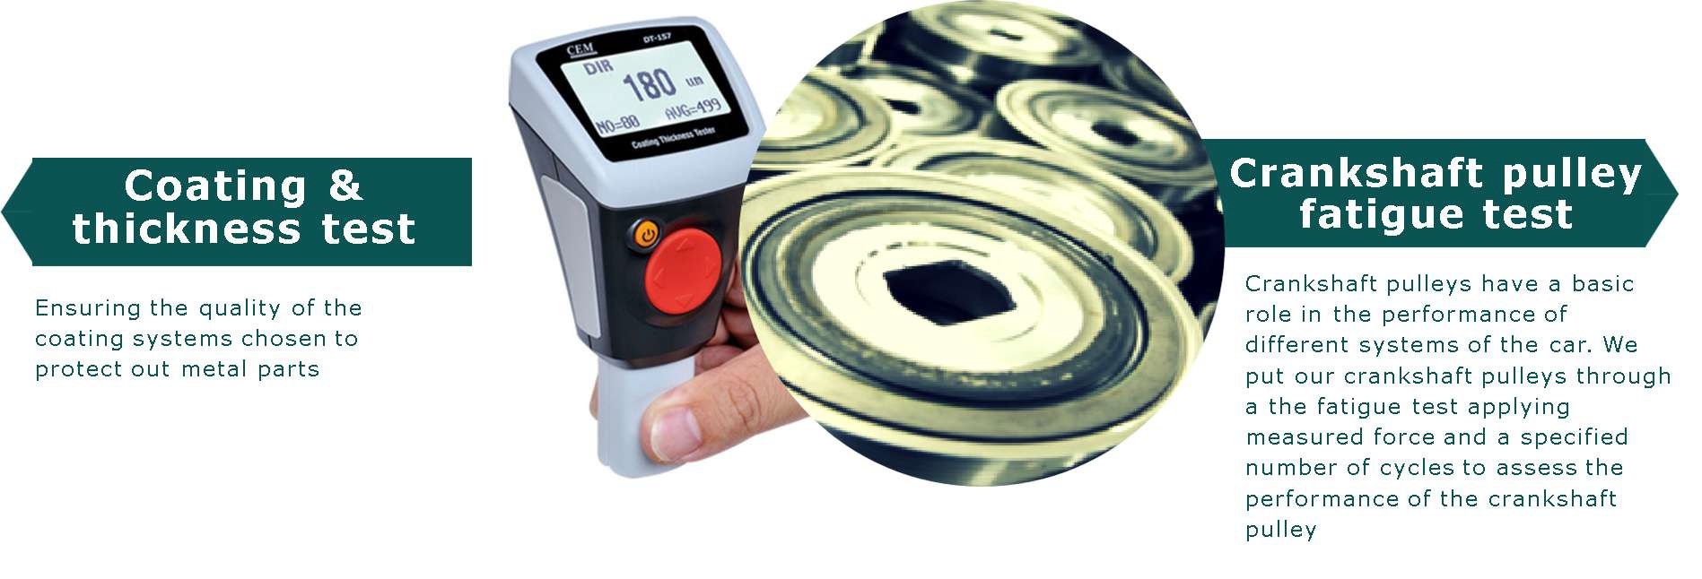
QUALITY CONTROL
ÜCEL 2023

Slide 16
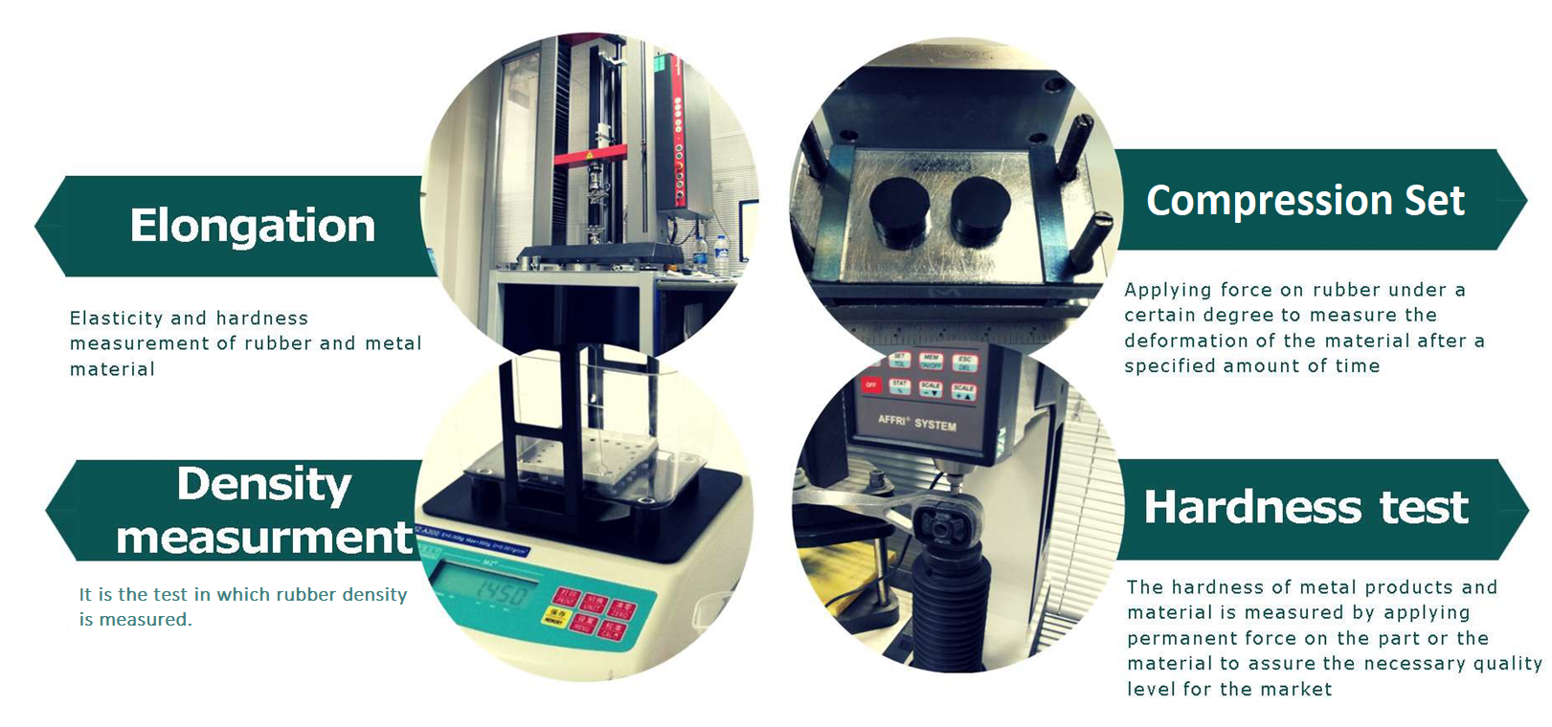
QUALITY CONTROL
ÜCEL 2023

Slide 17
OUTSTANDING BUSINESS SUPPORT
What we have already:
Low MOQ
Lead times in line with customers’ needs
Catalogs, Xrefs and support material
What comes next :
- Technical training
Communication tools
Installer focused tools
ÜCEL 2023

Slide 18
OUTSTANDING BUSINESS SUPPORT
TEC ALLIANCE CERTIFIED DATA
PROVIDER
ALDOC DATA PROVIDER
ÜCEL 2023

Slide 19
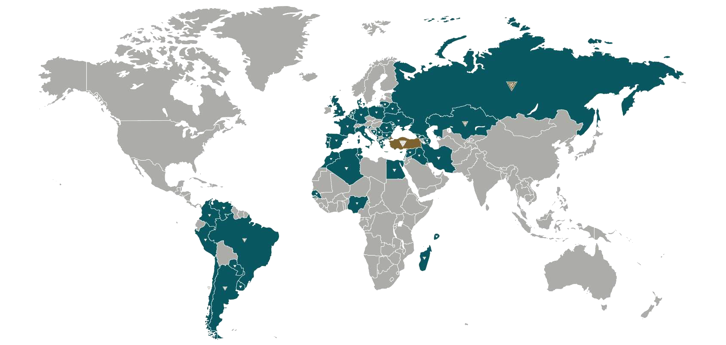
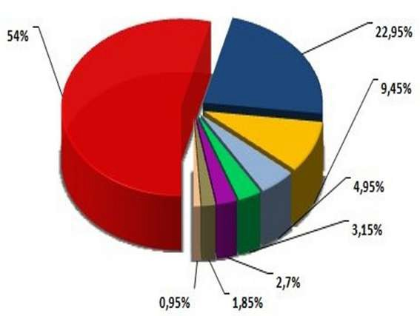
MARKETING & SALES
ÜCEL 2023

Slide 20
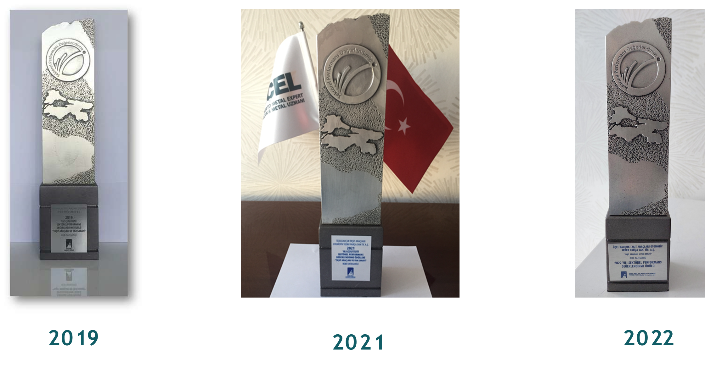
MARKETING & SALES
SECTORAL PERFORMANCE AWARDS
ÜCEL 2023

Slide 21
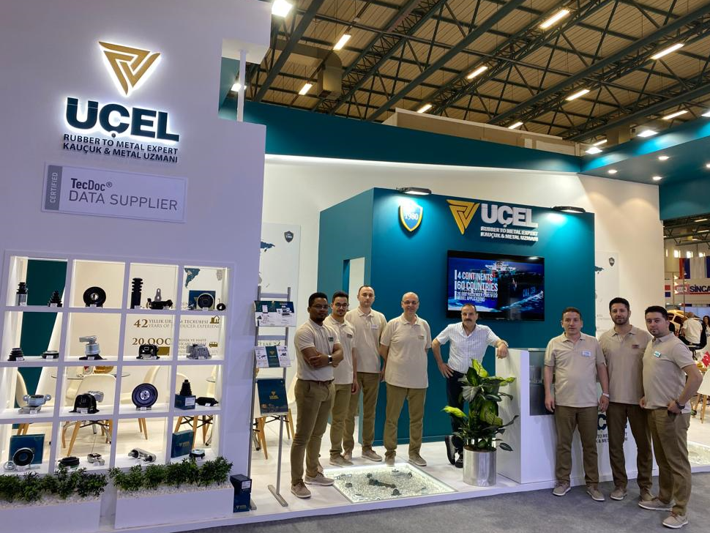
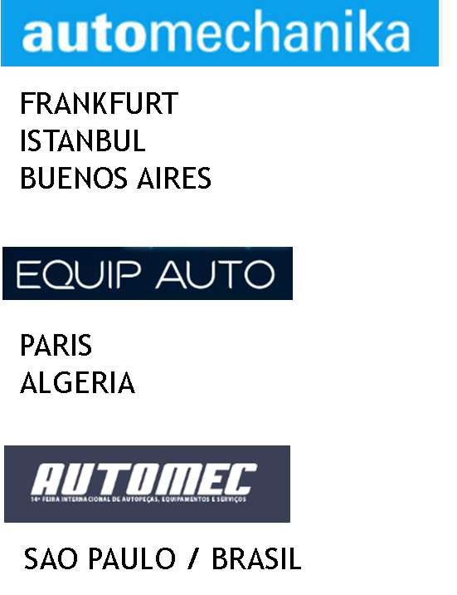
MARKETING & SALES
ÜCEL 2023

Slide 22
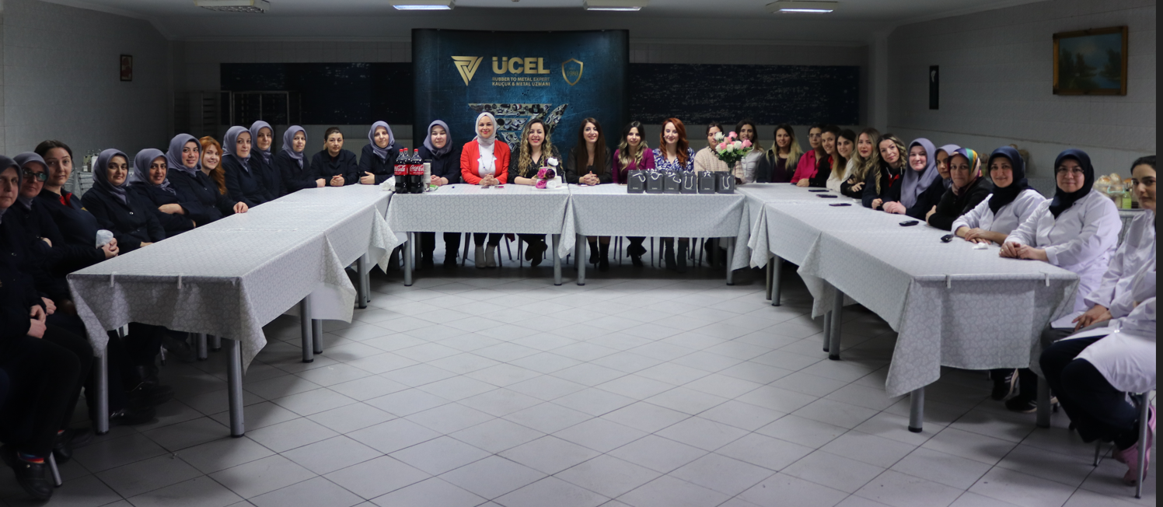
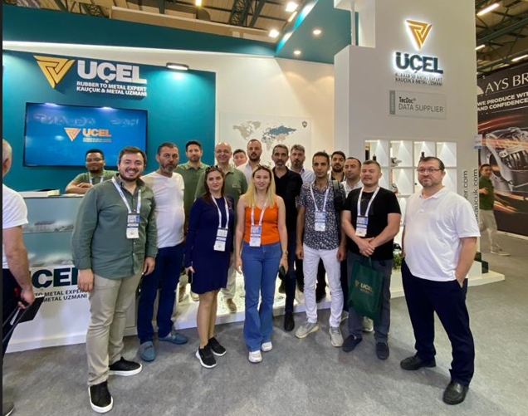
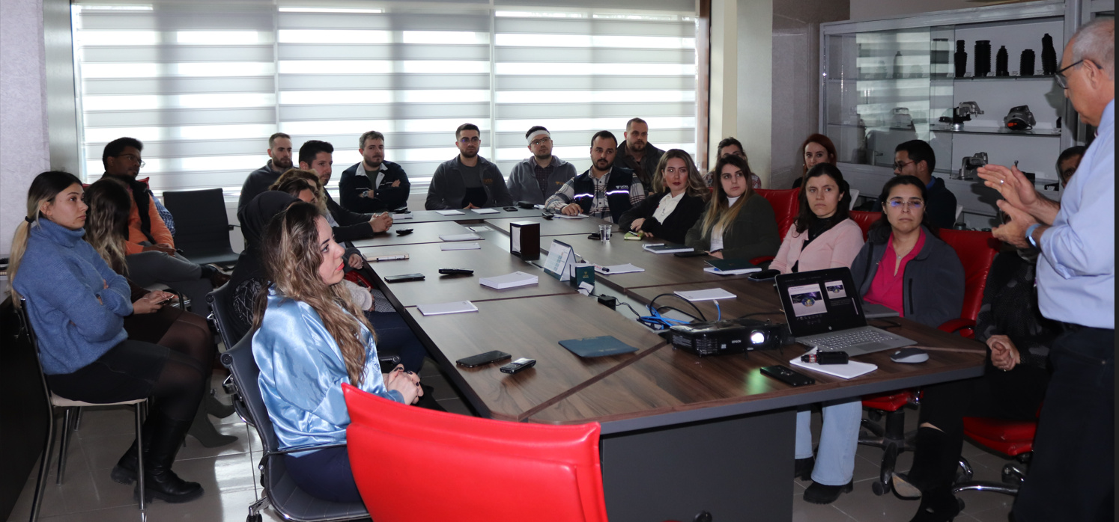
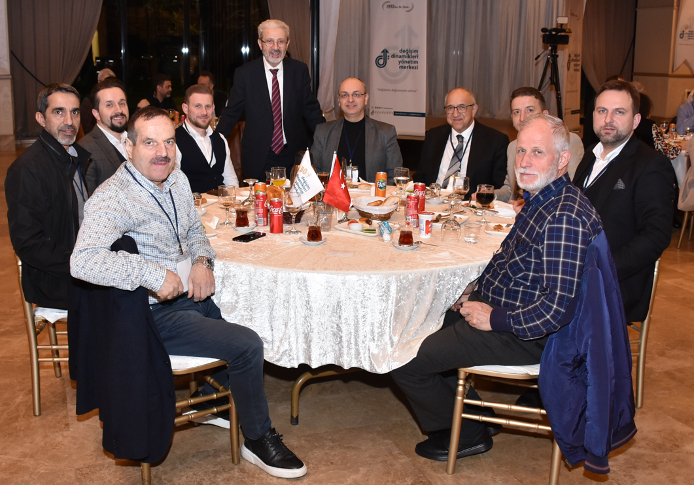
HUMANS OF ÜCEL
We invest in team building because we believe people are the most
valuable resource we have.
ÜCEL 2023

Slide 23
ÜCEL 2023

Slide 24
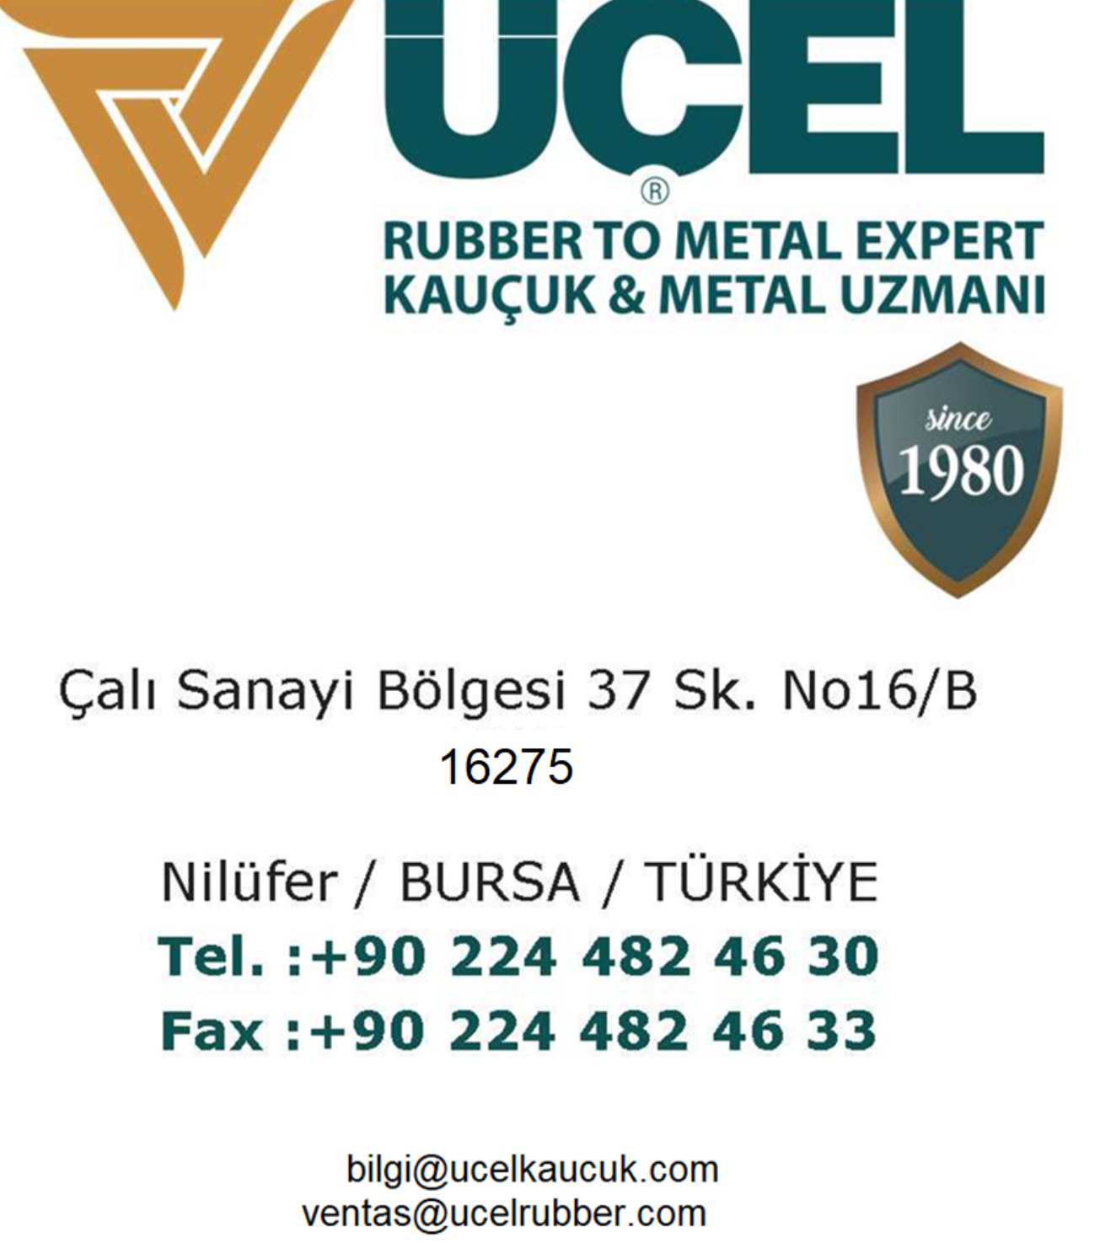
JOIN US ON
www.ucelrubber.com
ÜCEL 2023

